Slide 1
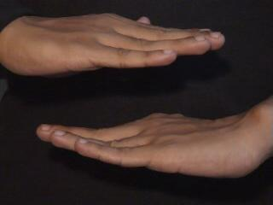

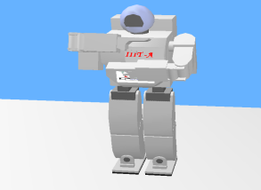
Imitation based Learning using human Gesture for Human Robot Interaction

Slide 2
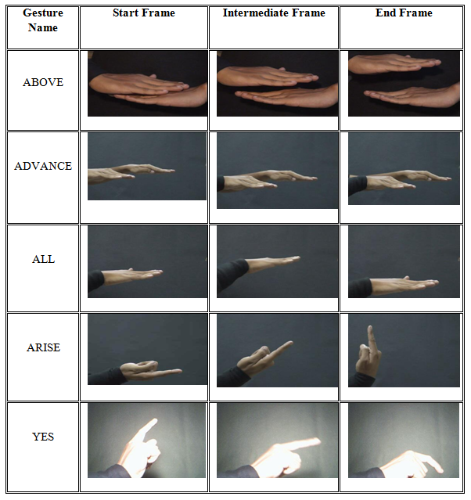
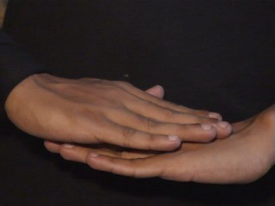
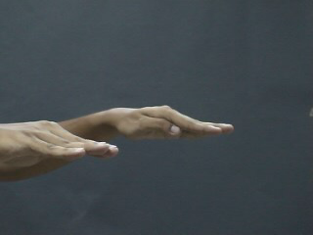
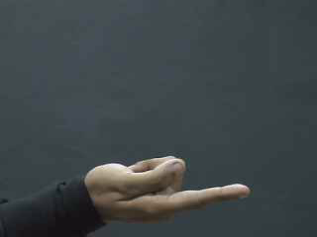
ISL Gesture Collection
Gesture acquisition:

Slide 3
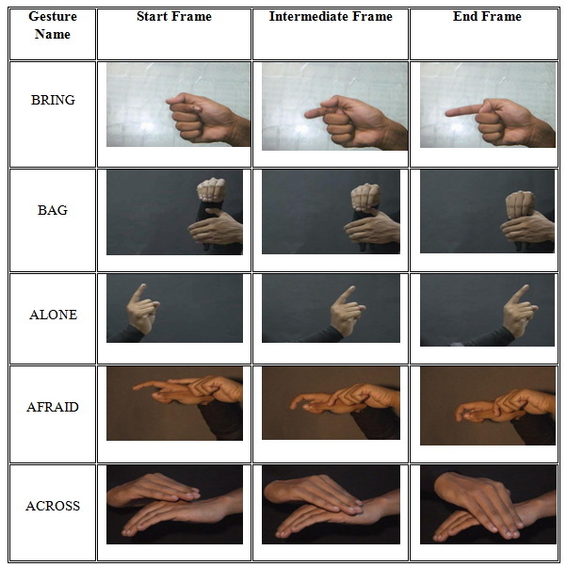
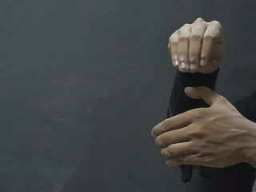
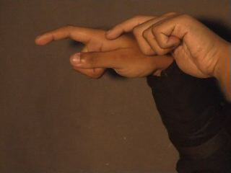
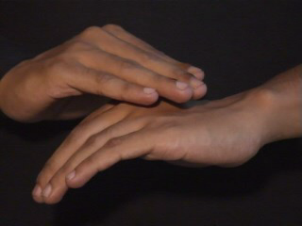
ISL Gesture collection
Gesture acquisition:

Slide 4
Simulation and Fast prototyping of mobile robot actions on Webots Simulation platform
Webots, mobile robotics simulation software
rapid prototyping environment for modeling, programming and simulating mobile robots
robot libraries enable to transfer control programs to several commercially available real mobile robots

Slide 5
Methodology & Implementation
Webots (the simulation environment)
Webots is a 3D mobile robotics simulation software that provides a fast and convenient way of modeling, programming and simulating mobile robots.
Creating a robot into Webots can be separated in four different phases:
Robot construction phases in Webots

Slide 6
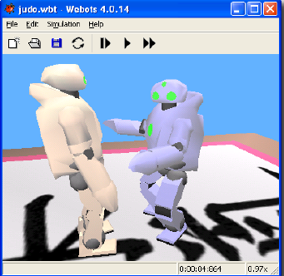
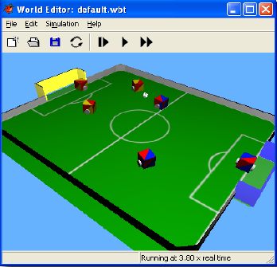
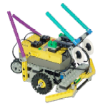
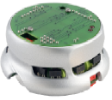
Simulation Examples
Humanoid robot modeling using physics
Multi-agent robot soccer simulation
LEGO Mindstroms
Khepera II

Slide 7
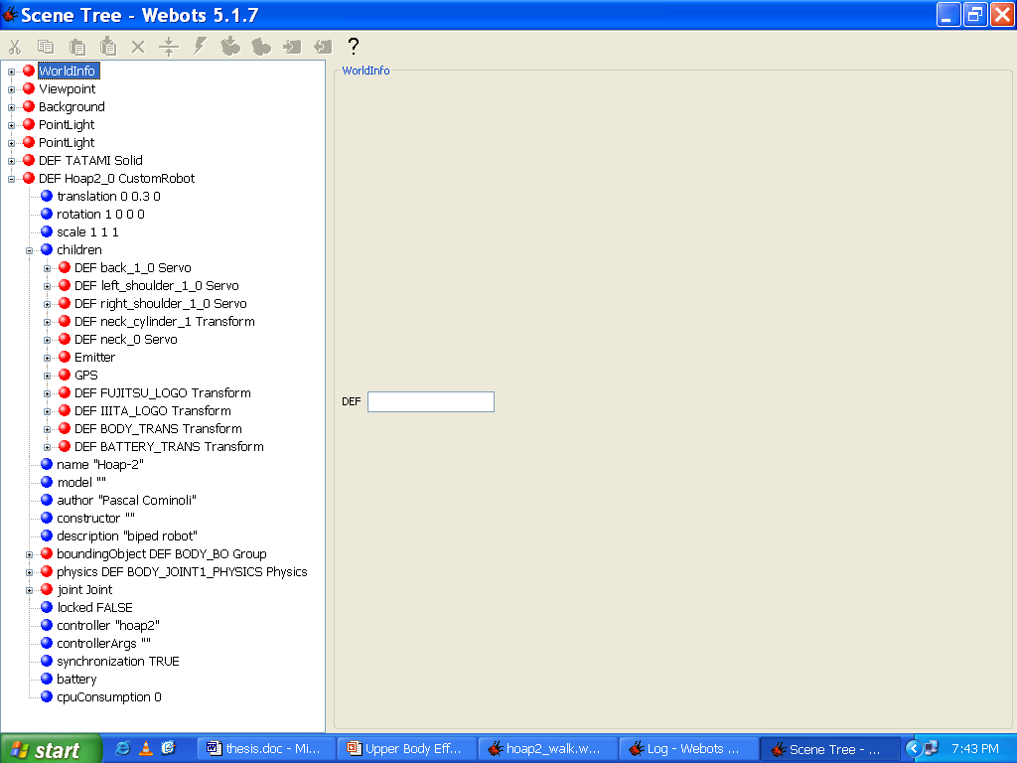
Methodology & Implementation (Webots) -Webots Phases
The description of the robot and its world
The first thing to do when using Webots is to build the model of the robot.
A GUI displays and allows editing the WRML tree describing the robot world (the robot and its environment). This tree can contain a large variety of different nodes.
Notes:
The first thing to do when using Webots is to build the model of the robot. That mainly means deciding what will be the shape of the robot, and placing all the joints and motors that will allow the robot to move.
The user can simply add the elements one by one with the GUI and directly see the result on the screen.
Each node represents one of the primitive offered by Webots to create the world. For example, one subset of these nodes are used to describe all the sensors that can be directly plugged into a robot; here is the list of these sensors:
• Distance sensors (Infrared & Ultrasound)
• Range finders
• Light sensors
• Touch sensors
• Global Positioning Sensor (GPS)
• Cameras (1D, 2D, color, black and white)
• Receivers
• Position sensors for the joints
• Incremental encoders for wheels
The number of these primitives furnished by Webots is huge. That allows us to create a very complete and accurate robot's model. So, the next step is to see how we can control and give life to a robot.

Slide 8
Methodology & Implementation (Webots) -Webots Phases
2. How to Control the Robot
To determine the behavior of the robot, the only solution is still to program the controller by hand.
But, the code will no more contain the part needed to build the model. Now, all the elements previously defined in the world will be accessible in the code through the Webots' API.
Notes:
In the previous section the model of the robot was built with a nice looking GUI.
The code can be written in C, C++ or in Java. But the functions available are the same for the three languages.
So the choice is mostly a matter of taste. For this thesis, the controllers were programmed in C.
Once the controller is written and compiled, the binary file generated must simply be put in a particular directory and Webots will use it.

Slide 9
Methodology & Implementation (Webots) -Webots Phases
3. The Simulation
We just need to launch Webots, open the file containing the world and then click the "play" button.
The simulation can run in real time mode. But Webots can also make the simulation run as fast as it can, by using all the resources of the machine on which it is running.
Notes:
To summarize the situation we now have a WRML file describing the world, and a C program describing the behavior of the robot. No more is needed to launch a simulation and to see our robot moving in his 3D virtual environment.

Slide 10
Methodology & Implementation (Webots) -Webots Phases
4. The transfer to a real robot
Once the simulation runs well and fits the will of the user, the program doing the control can easily be uploaded to the real robot.
Of course, this feature is limited to a very limited set of robots, like the Khepera or the Koala robot.
Unfortunately, at present, it is not available for Hoap-2 robot because of the unavailability of a cross compiler for transferring the code to the robot.

Slide 11
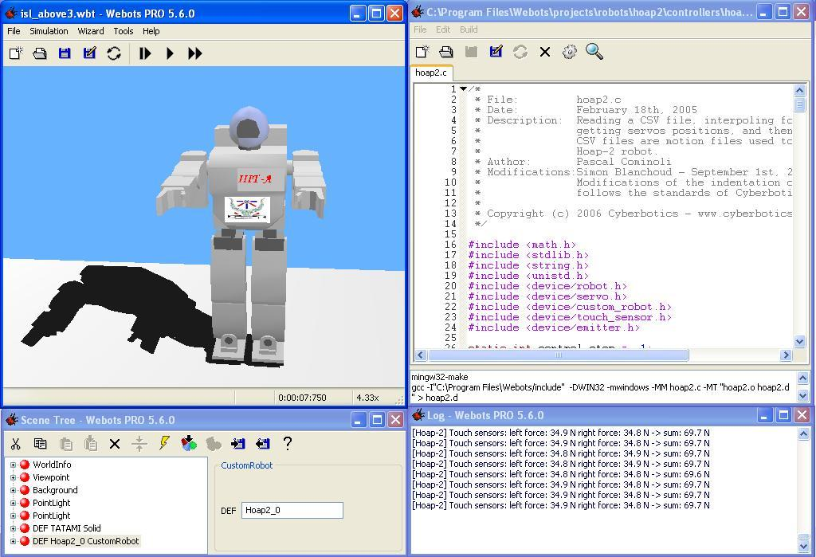
Learning of human gesture
Webots Specification
WEBOTS is simulation robotics software which provides comprehensive facilities towards modeling, programming (with C, C++ and Java) and simulating for any kinds of robots.

Slide 12
Methodology & Implementation
parts that belong to upper body:
head_joint_1,head_joint_2, larm_joint_1,larm_joint_2, larm_joint_3,larm_joint_4, larm_joint_5,rarm_joint_1, rarm_joint_2,rarm_joint_3, rarm_joint_4,rarm_joint_5
parts that belong to lower body:
body_joint_1,lleg_joint_1, lleg_joint_2,lleg_joint_3, lleg_joint_4,lleg_joint_5, lleg_joint_6,rleg_joint_1, rleg_joint_2,rleg_joint_3, rleg_joint_4,rleg_joint_5, rleg_joint_6

Slide 13
Learning of ISL gesture
HOAP-2 Specification
HOAP-2 stands for Humanoid for Open Architecture Platform.

Slide 14
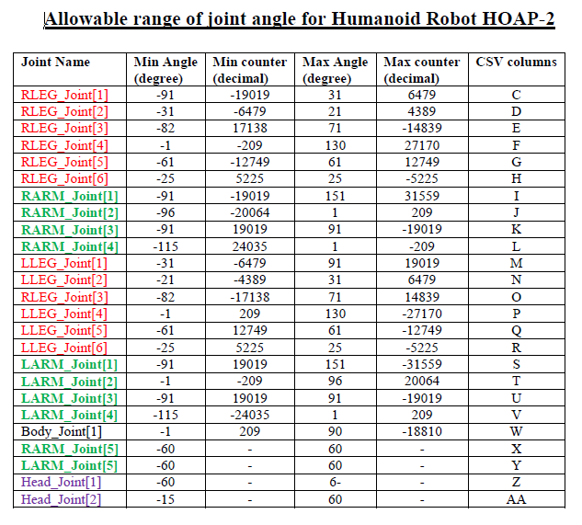

Slide 15
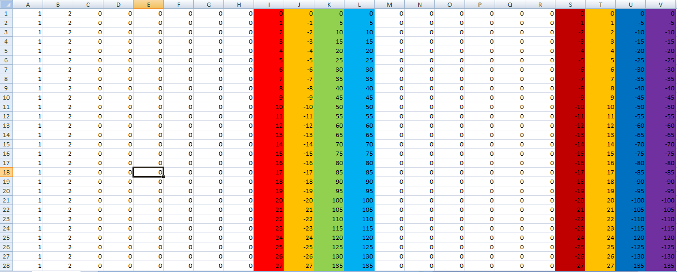
HOAP -2 Controller

Slide 16
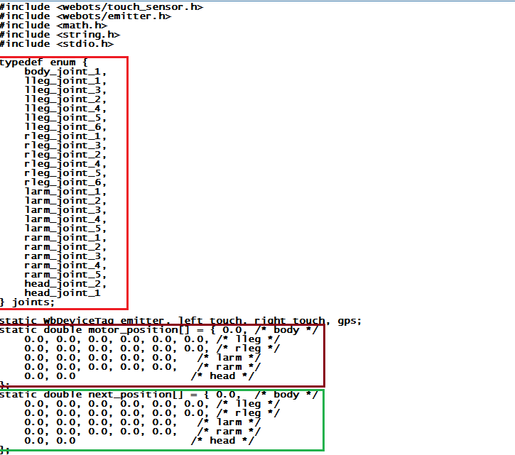
Controller Code -> HOAP-2

Slide 17
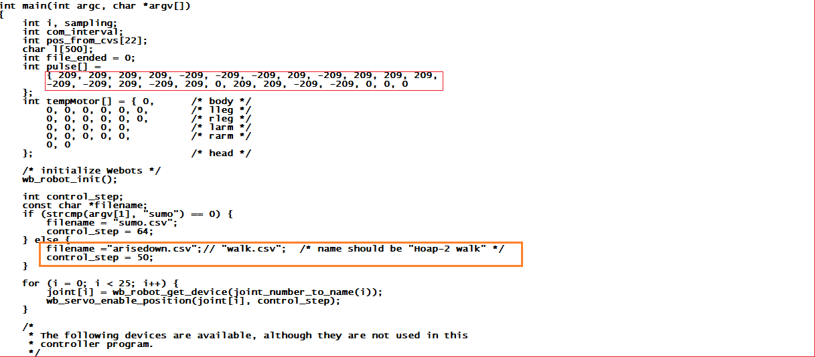
Controller Code -> HOAP-2

Slide 18
Learning of gesture by HMM
Captured the ISL gesture as an input gesture
Apply an algorithm for extracting feature like orientation histogram to construct feature vector of equal size for all the ISL gestures.
From the feature vector of each gesture an initial codebook is to be generated. Then apply LBG algorithm to generate an optimized codebook.
Each row corresponds to a number of the codeword which helps to form a quantized vector used by hmm algorithm.

Slide 19
Viterbi algorithm used for testing
=
The transition and emission probability are obtained for each trained ISL gesture model.
We apply viterbi algorithm for each gesture model with the given transition and emission matrices.
The parameters passed through the viterbi algorithm are codebook sequence, TRANS and EMIS matrices.
It computes the most probable state sequences by which the model generates the given sequences.
If the new gesture comes for testing then we will have to find out the likely states sequence of that gesture in the same manner.

Slide 20
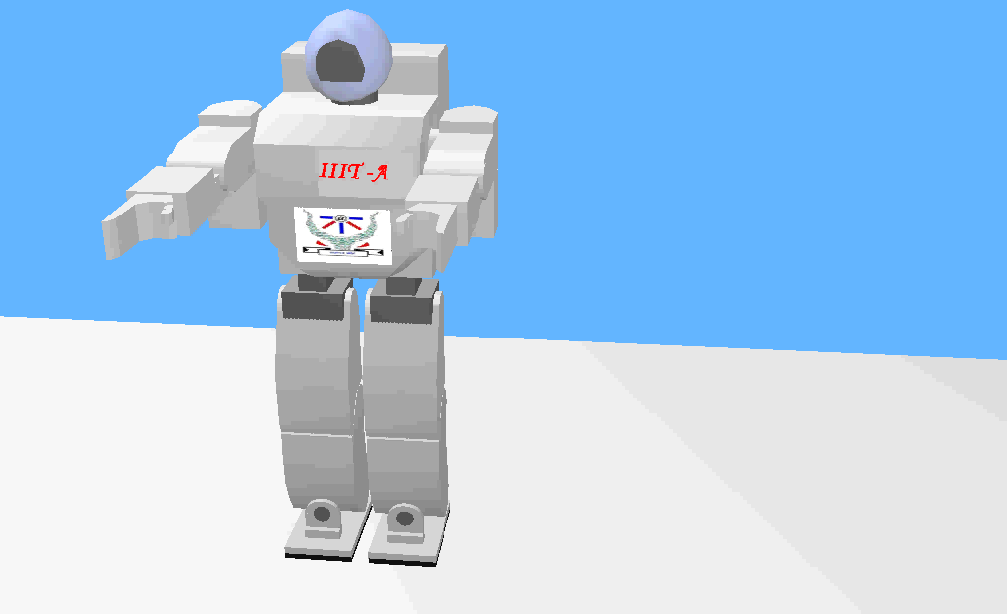

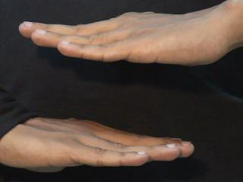
Imitation Learning mechanism
ISL Above gesture
ISL Below gesture

Slide 21
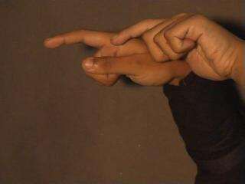

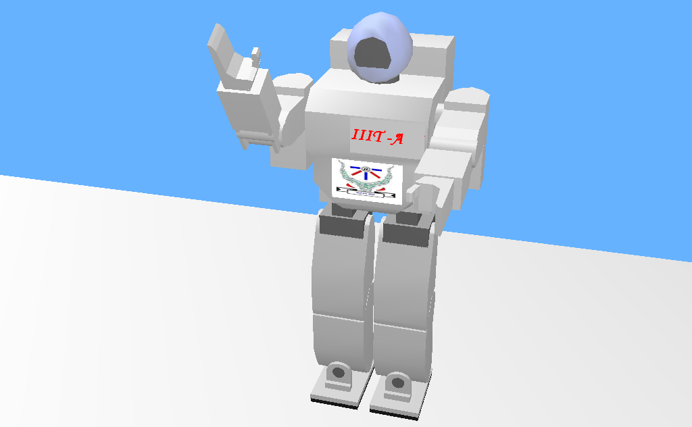
Imitation Learning mechanism
ISL Afraid gesture
Click to see video
ISL Arise gesture

